Slide 1
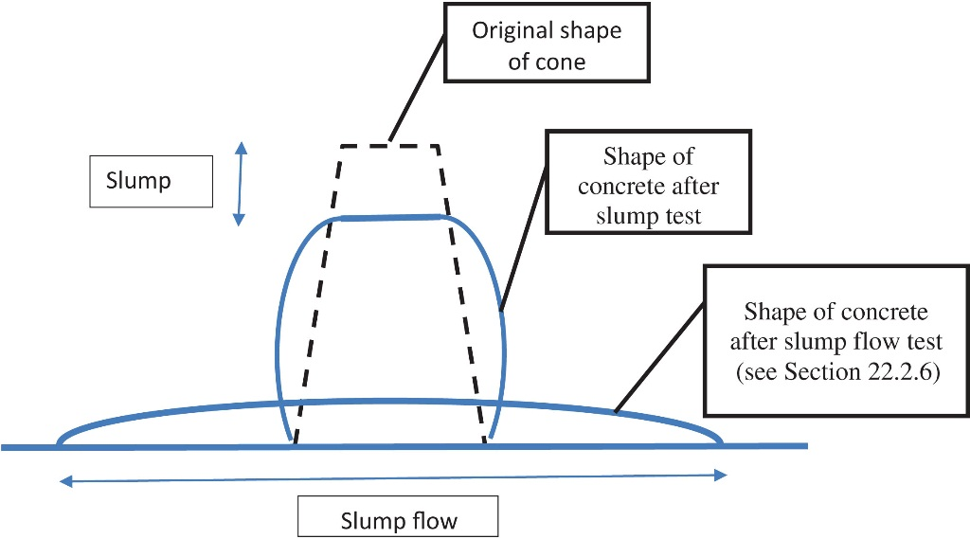
FIGURE 22.1 Schematic Diagram of Slump and Slump Flow Tests

Slide 2
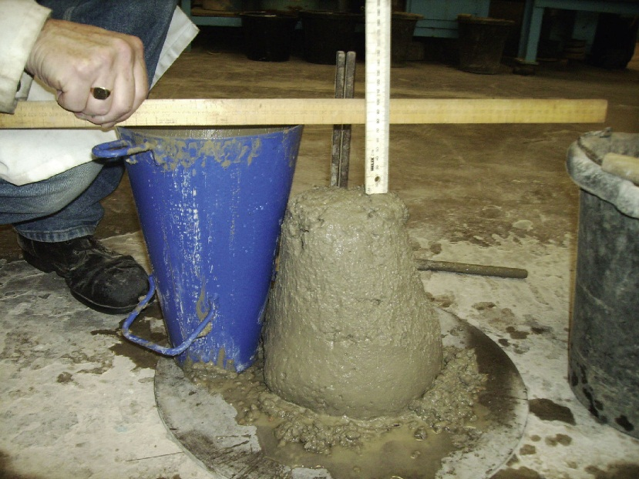
FIGURE 22.2 The Slump Test

Slide 3
FIGURE 22.3 The Degree of Compactability Test

Slide 4
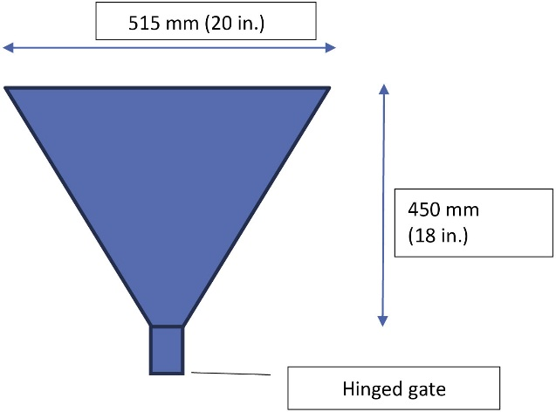
FIGURE 22.4 Schematic Diagram of V Funnel Test

Slide 5
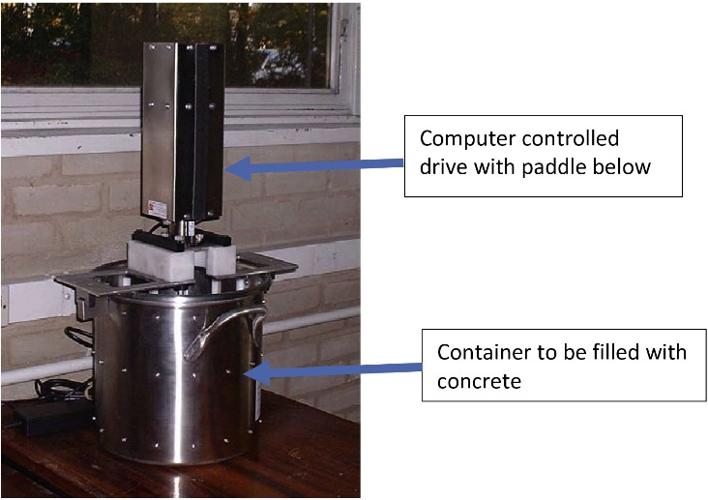
FIGURE 22.5 Concrete Viscometer

Slide 6
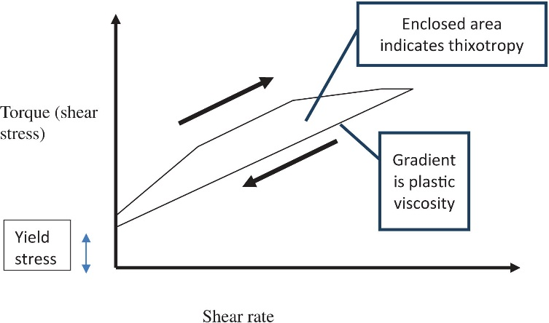
FIGURE 22.6 Schematic Output From Viscometer

Slide 7
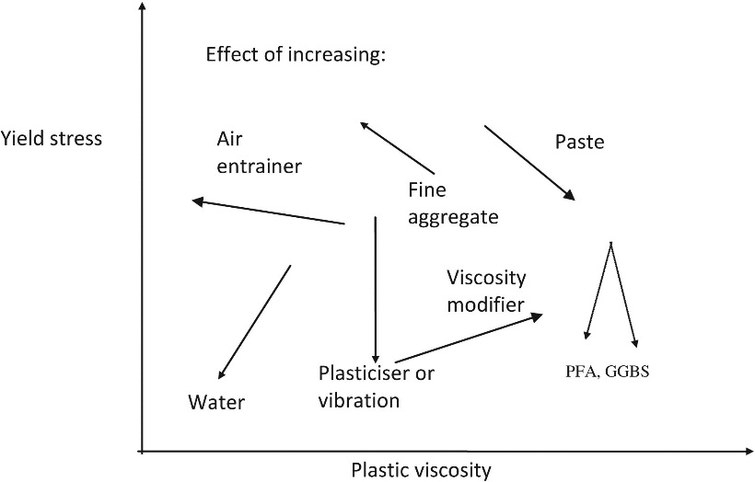
FIGURE 22.7 Effect of Increasing Parameters of the Mix

Slide 8
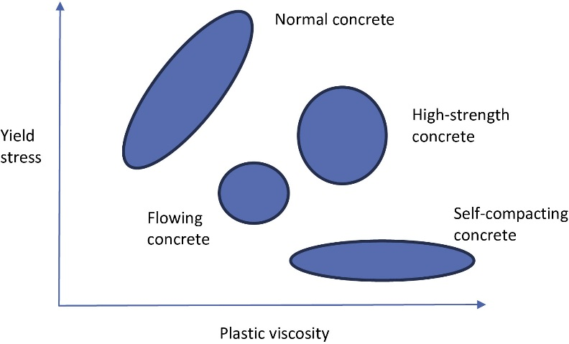
FIGURE 22.8 Types of Concrete

Slide 9
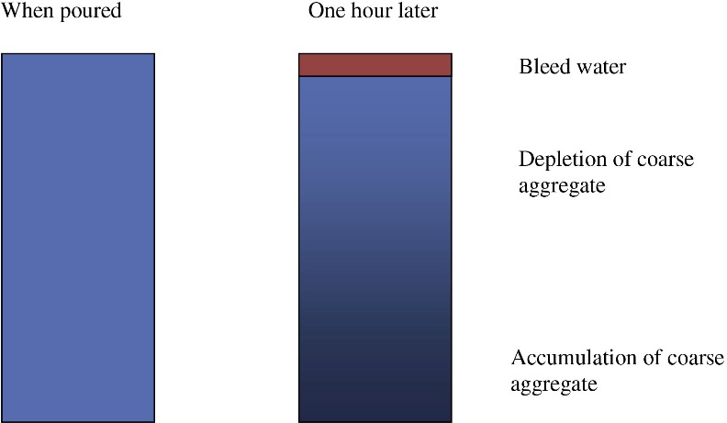
FIGURE 22.9 Schematic Diagram of Bleed Test

Slide 10
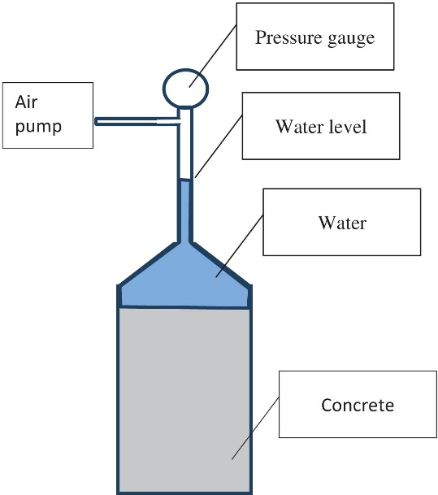
FIGURE 22.10 Air Content Meter

Slide 11
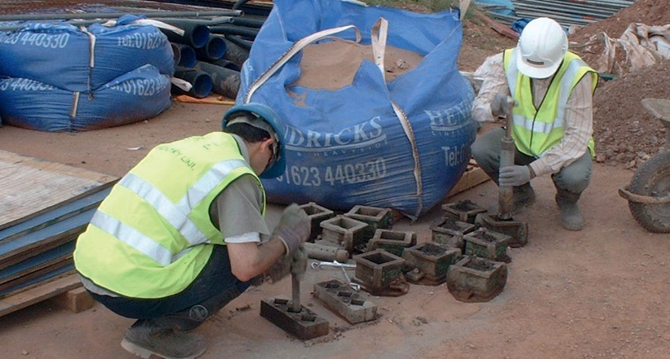
FIGURE 22.11 Compacting Test Cubes on Site

Slide 12
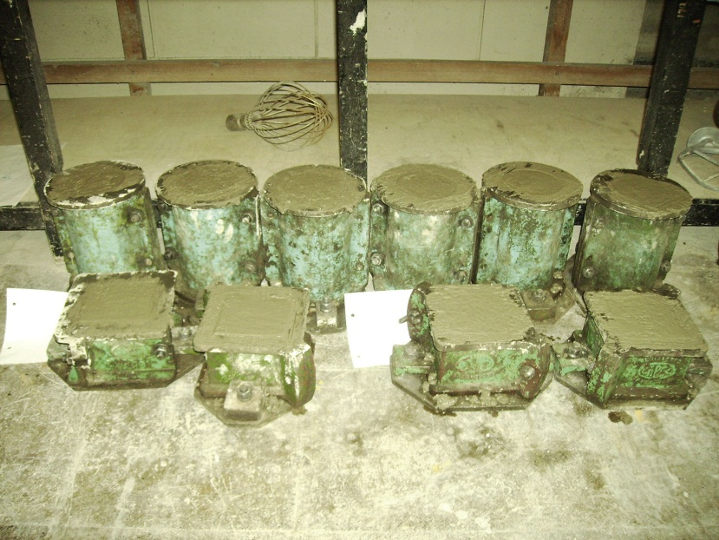
FIGURE 22.12 Filled Cube and Cylinder Moulds

Slide 13
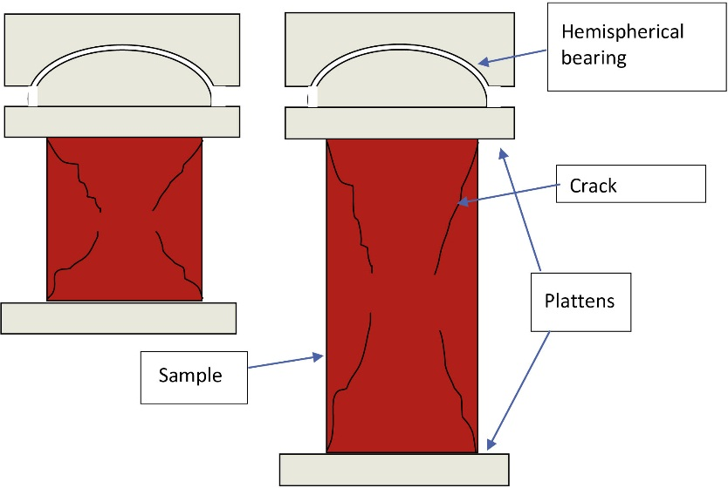
FIGURE 22.13 Crushing Cylinder (Right) and Cube (Left)

Slide 14
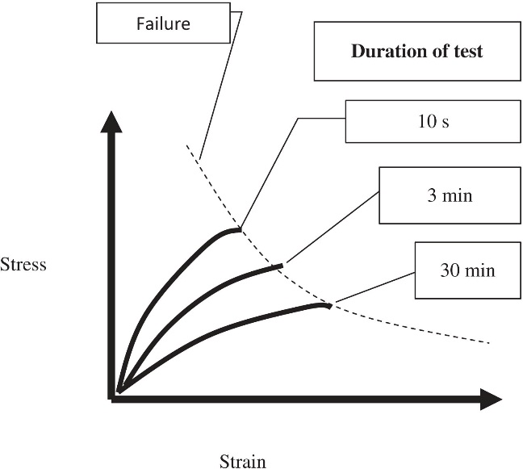
FIGURE 22.14 The Effect of Increasing Load Rates

Slide 15
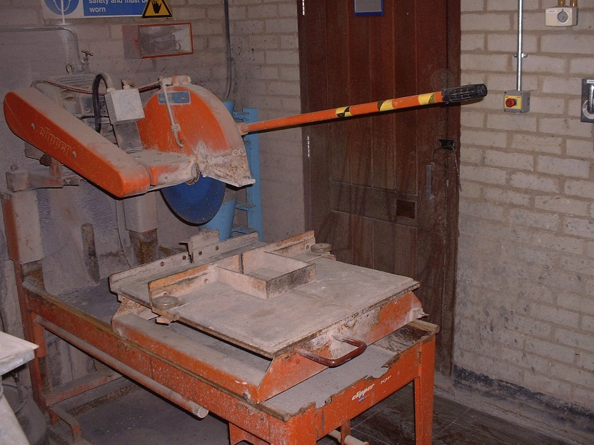
FIGURE 22.15 Chop Saw for Preparing the Ends of Cylinder Samples for Compression Test

Slide 16
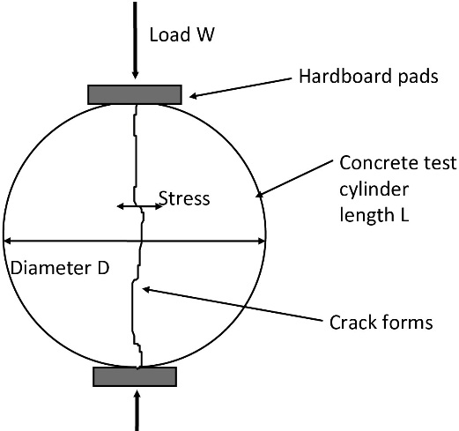
FIGURE 22.16 Schematic Diagram of Cylinder Splitting Test

Slide 17
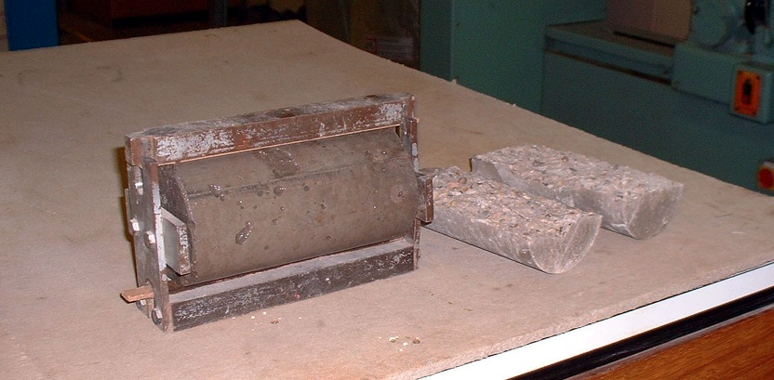
FIGURE 22.17 Cylinder Sample in Frame for Splitting, and Split Sample After Testing

Slide 18
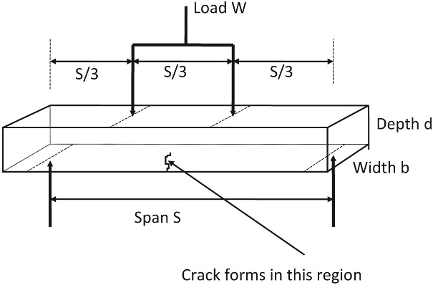
FIGURE 22.18 Schematic Diagram of Flexural Test

Slide 19
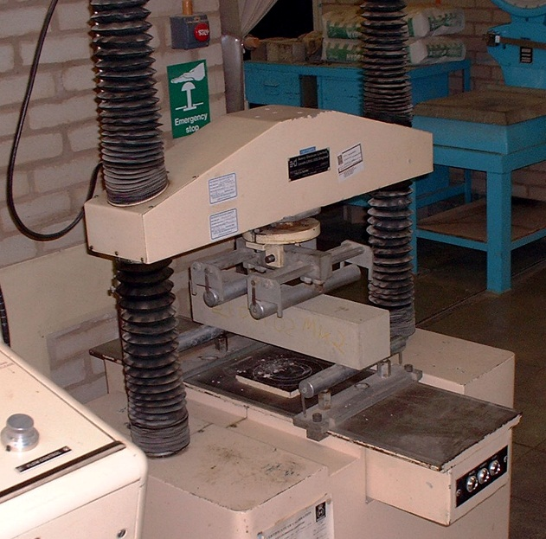
FIGURE 22.19 Flexural Test on Concrete Prism

Slide 20
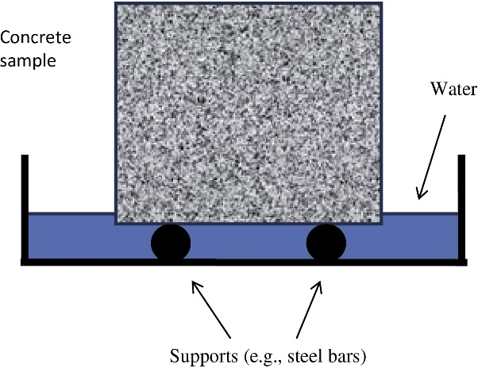
FIGURE 22.20 Schematic Diagram of Sorptivity Test

Slide 21
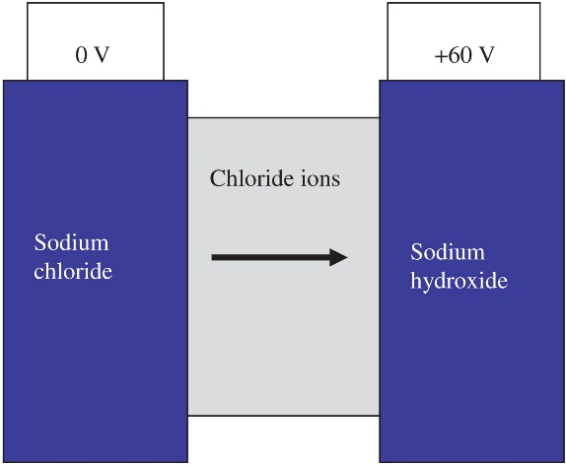
FIGURE 22.21 Schematic Diagram of “Rapid Chloride Migration” Test

Slide 22
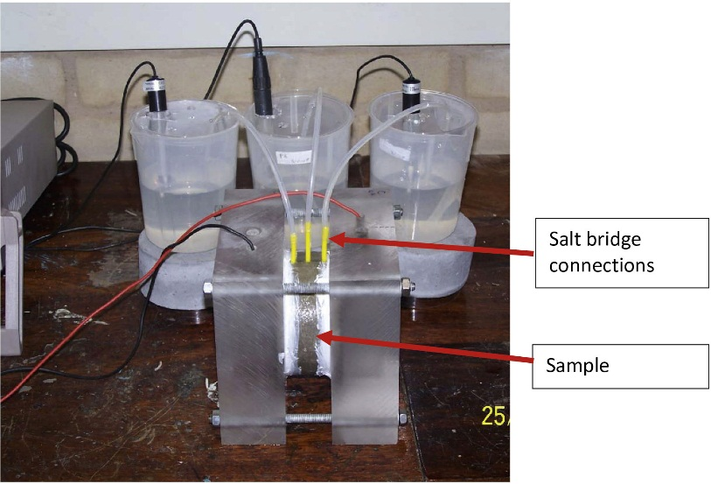
FIGURE 22.22 The Rapid Chloride Migration Test

Slide 23
